Slide 1
Azure Rhythm
Cloud Miners SMU - 2023

Slide 2


The Idea…

Slide 3
Presentation Journey
R Shiny Application - Haitie
ETL - Mai
Azure Database – Lijo
Azure Machine Learning – Todd
Guided by Lani

Slide 4
Azure Rhythm R Shiny Application
Haitie Liu

Slide 5


Azure Rhythm R Shiny Application
https://azrhythmwebapp.azurewebsites.net/

Slide 6
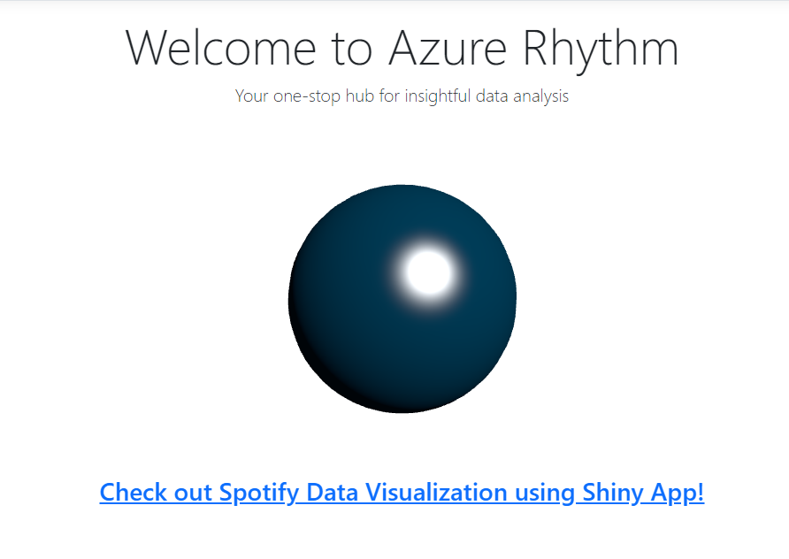
Screenshots of our R Shiny App

Slide 7
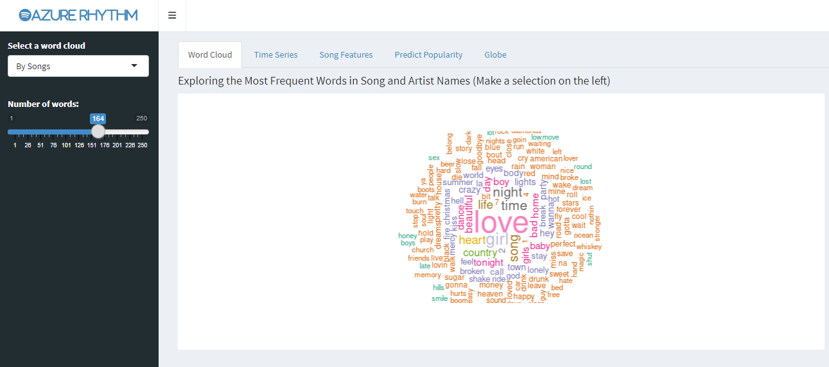
Screenshots of our ShinyApp

Slide 8
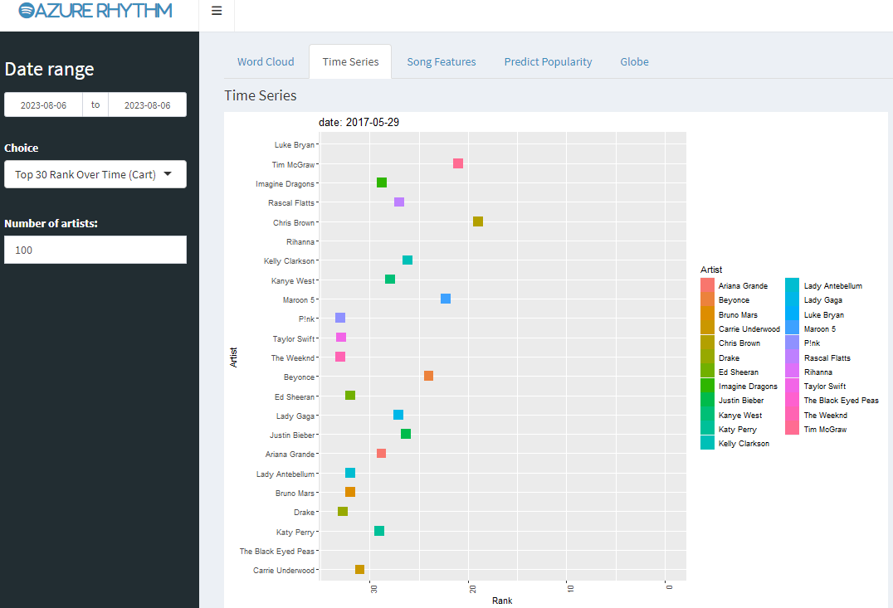
Screenshots – R Shiny App

Slide 9
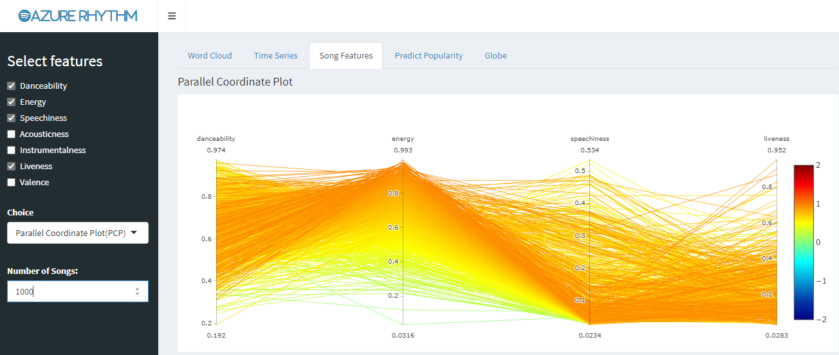
Screenshots – R Shiny App

Slide 10
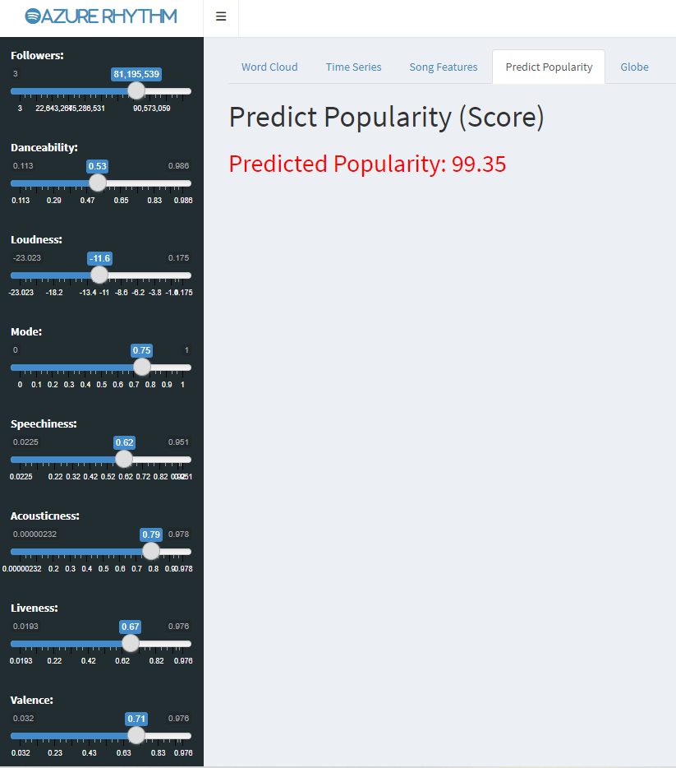
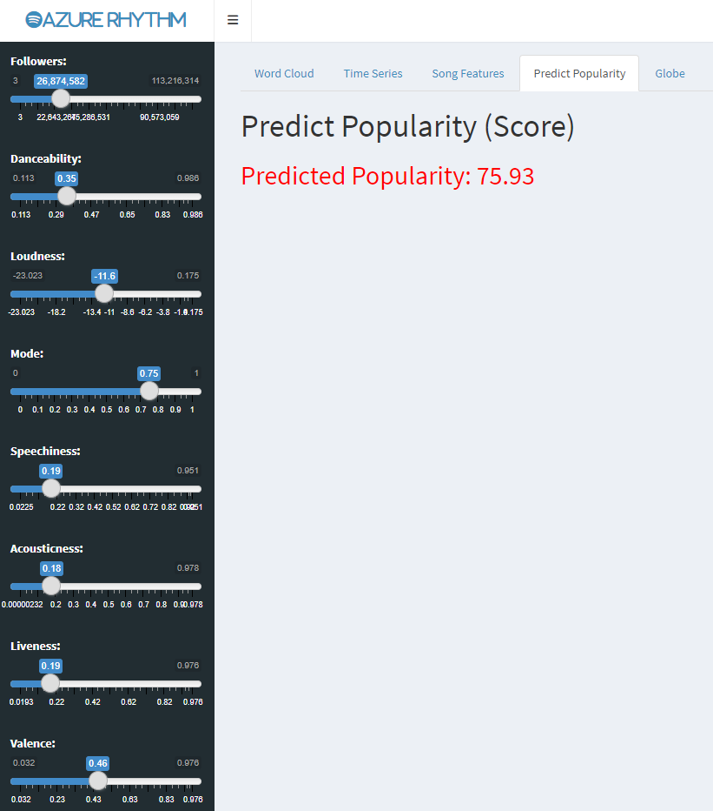
Screenshots – R Shiny App

Slide 11
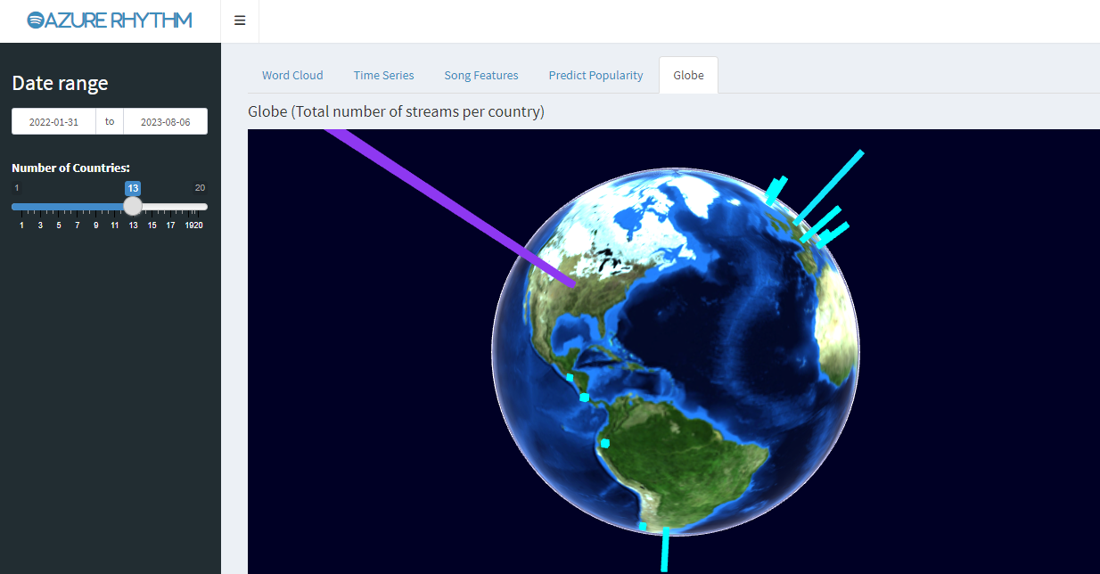
Screenshots – R Shiny App

Slide 12
Extract, Transfer, Load (ETL) Python
Mai Dang

Slide 13
ETL
Extract
Transform
Load

Slide 14


Extract
Artists(2195)
Top50
Songs&artists
Tracks (7687)
Audio_features
(7867)
SongWWD
Albums
(3745)
Using library Spotipy

Slide 15
Extract
Roadblocks
Spotify API limits: rate limit, token limit, etc.
Duplicated IDs
Inconsistent artist names in 2 datasets
Solutions
Client Credential authentication
Break between loops
Response Counter.
Check and remove duplicates.
Remove symbols and characters before normalizing the artist names.

Slide 16
ETL
Extract
Transform
Load

Slide 17
Transform
Chart
(57299)
Release
(9967)
Top50
Artists(2195)
Song_artist_df
Tracks (7687)
Audio_features
(7687)
Song
Ranking
Album_Info
(3745)
SongWWD
(198409)
Album
(3745)
Country Code
(250)

Slide 18
ETL
Extract
Transform
Load

Slide 19
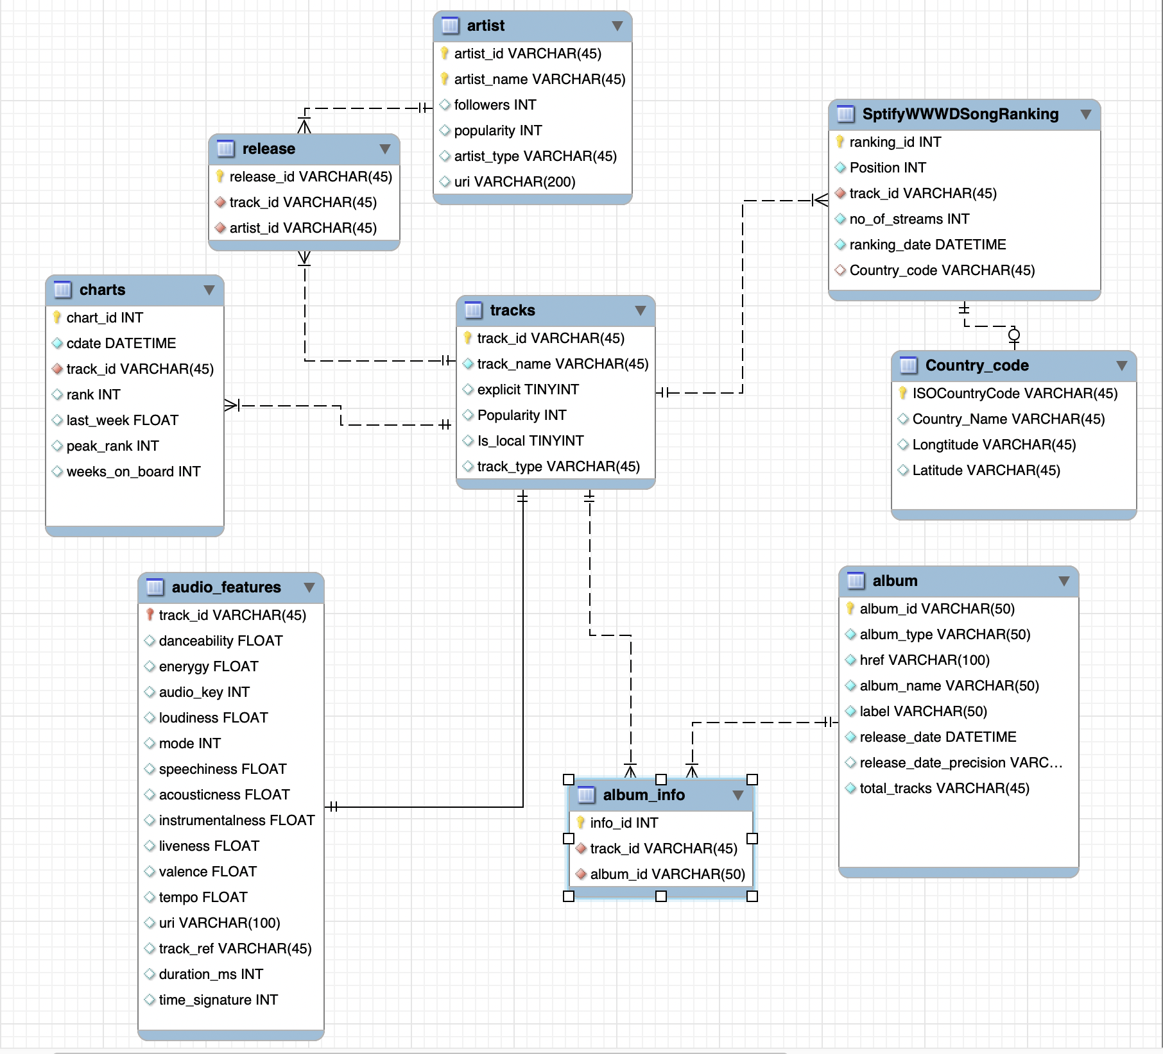
ERD

Slide 20
Azure Database
Lijo Jacob

Slide 21
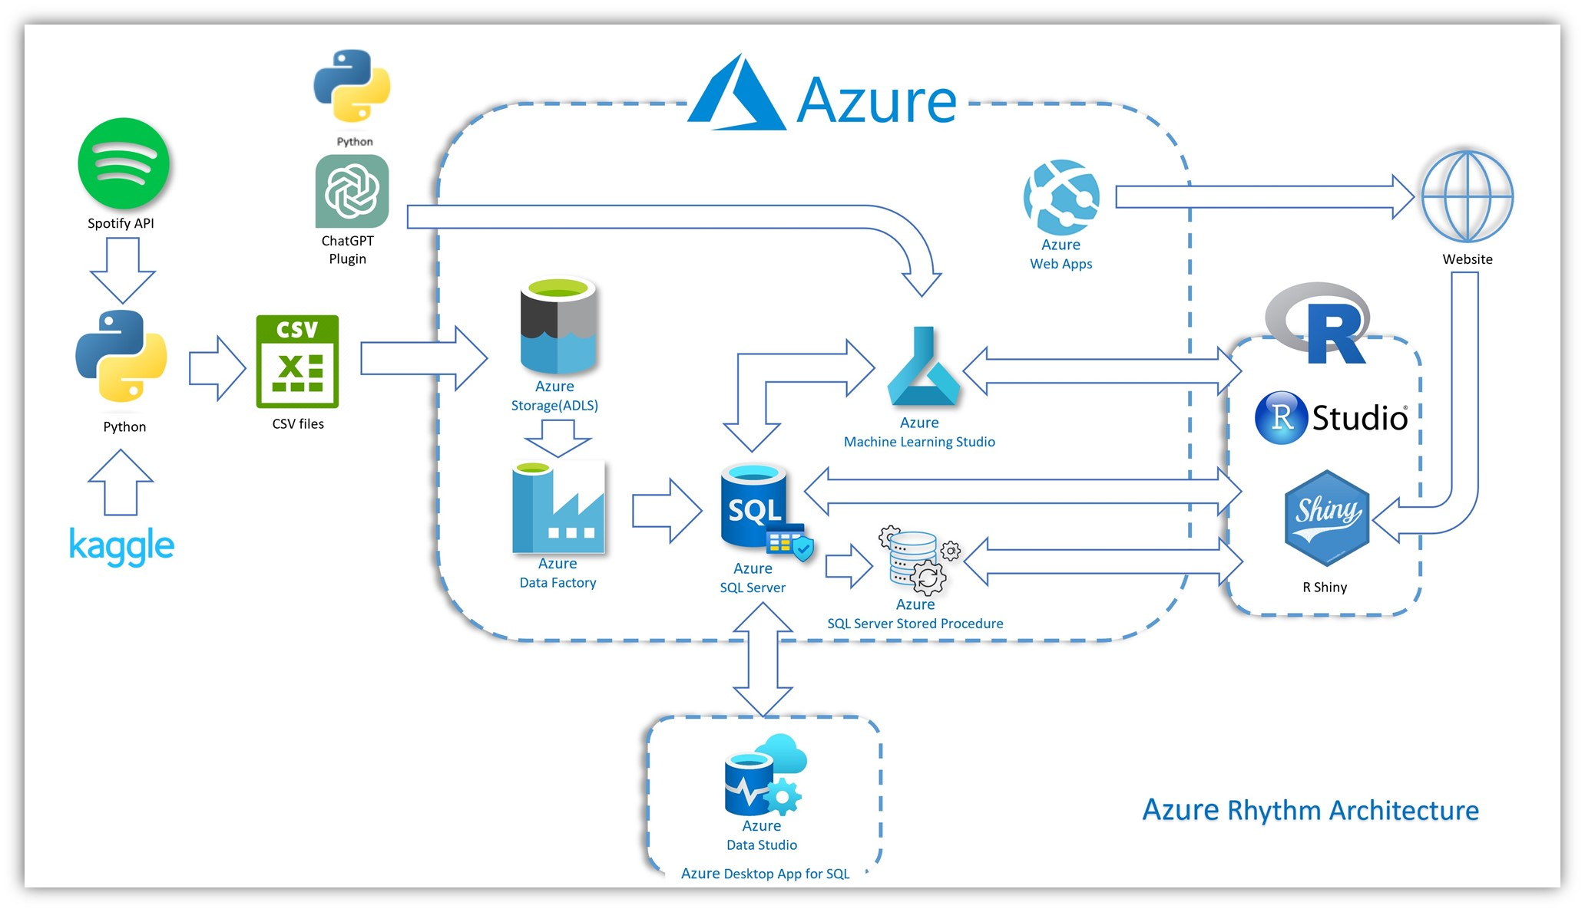

Slide 22
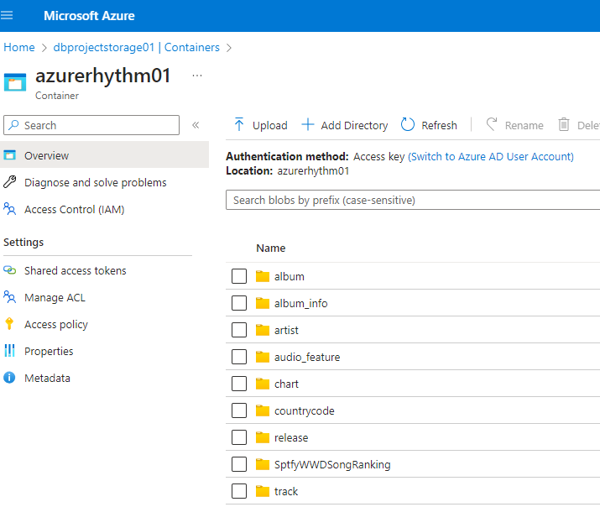

Azure Setup & Data Migration to Azure
Setup Azure student account for each team member.
Created resources under one of our subscriptions and assigned “Contributor” role to each team member.
Setup a storage account and created a container
Data stored in csv files were migrated to Azure data lake storage.

Slide 23

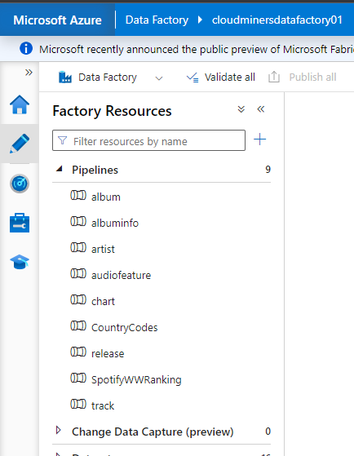
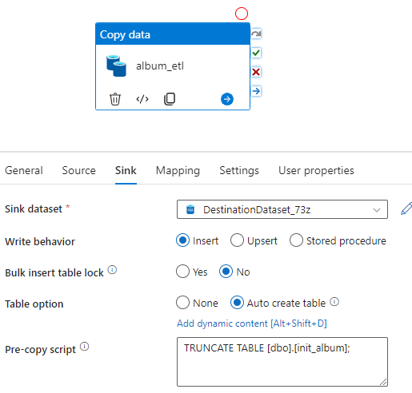
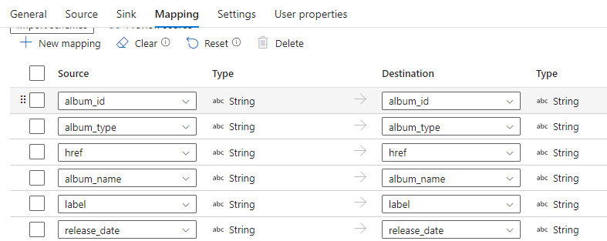
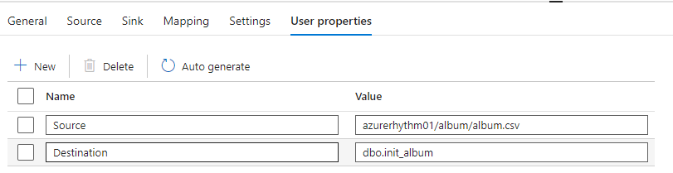
Data Ingestion to Azure SQL
Data stored Azure data lake storage is ingested into Azure SQL using Azure Data Factory

Slide 24

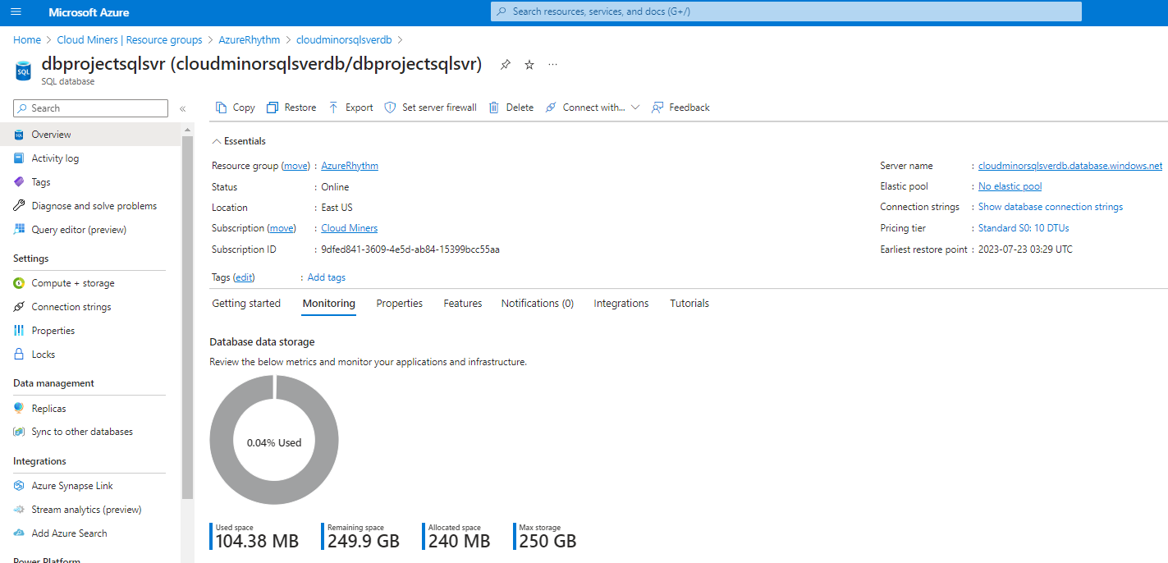
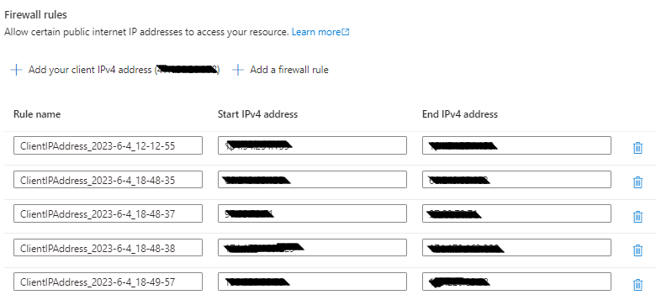
Azure SQL Setup
Created a sql server and sql database
Setup firewall rules to allow our machines to access the sql server using Azure data studio and R.

Slide 25
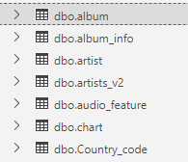
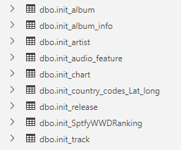
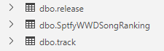
Relational Database Tables using Azure SQL
For data ingested using Azure Data Factory, the landing tables are named as “init_<file_name>.
Relational tables are created with key constraints and appropriate data types as per the ER Diagram.

Slide 26
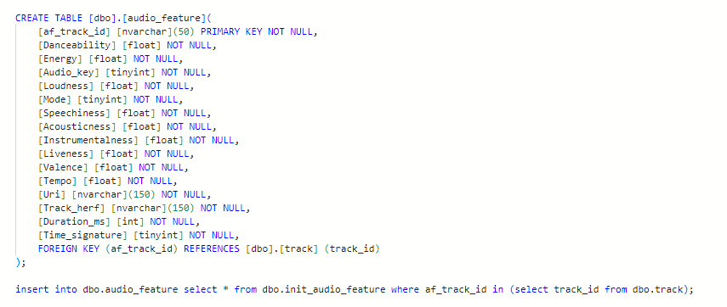
Relational Table Creation and Data Insertion
Table are created with Primary Keys and Foreign keys using create table statements.
Data is inserted into the table from corresponding landing table with appropriate foreign key table lookup.

Slide 27
MACHINE LEARNING THE FORMULA FOR SUCCESS!
Todd Garner

Slide 28
Why Azure Machine Learning?

Slide 29
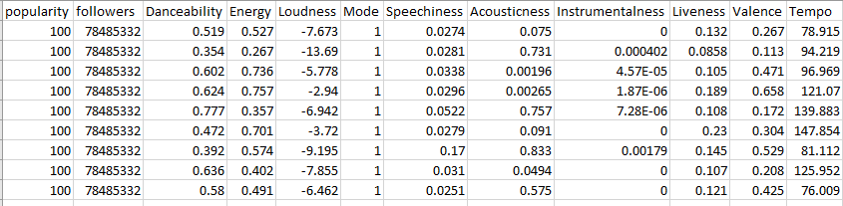
Introduction and Problem Statement
11 independent variables from Spotify, one response variable (popularity).
Notes:
I want to remove this slide…and you talk to it with the next slide…

Slide 30
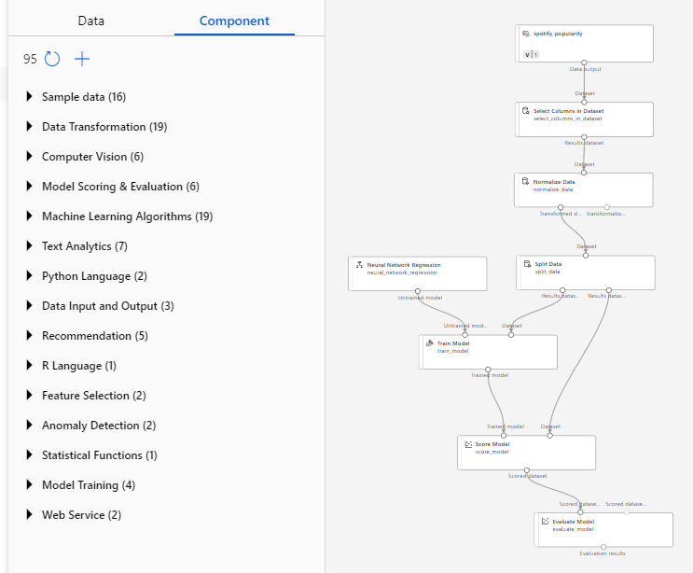
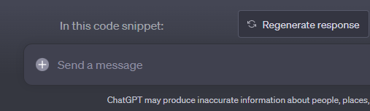
Methodology and Solution
Derived Linear Regression Equation
Popularity = 61.3331 + (3.93X10⁻⁷)×Followers + (11.5315)×Danceability – (0.0847)×Loudness – (1.5251)×Mode + (12.5477)×Speechiness – (2.2467)×Acousticness + (0.1258)×Liveness – (6.2922)×Valence + (0.0101)×Tempo
Notes:
I think a link and you do a quick walk through would be more of a benefit then this slide

Slide 31
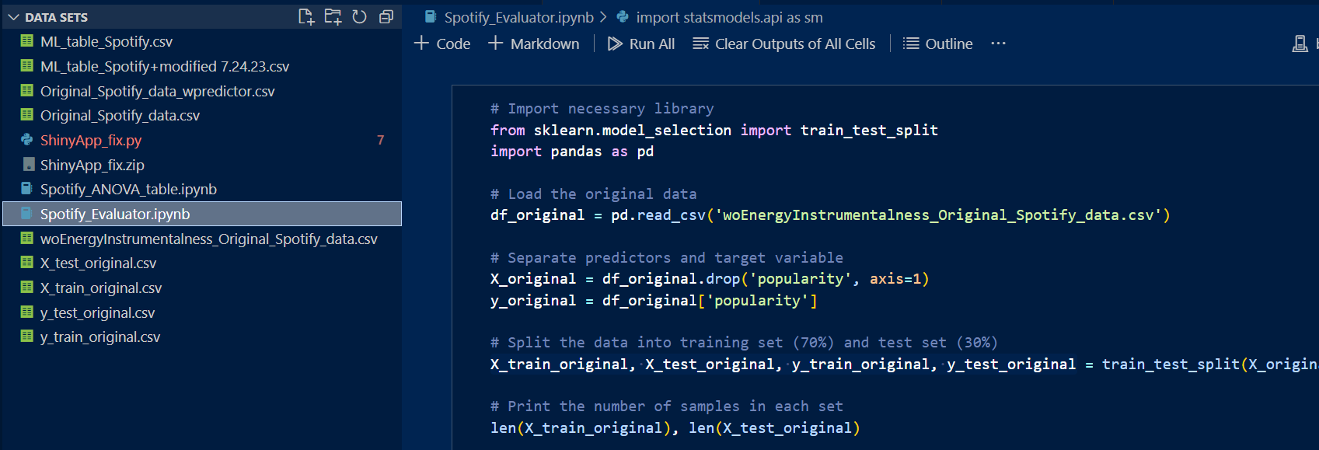
VS Code – Python – Linear Regression
Finally, I used VS Code and wrote a Python script and obtained a solution

Slide 32
Results and Application
Notes:
I think we should remove this slide as this was created in excel…we can talk about if we had more time and then hand it over…

Slide 33
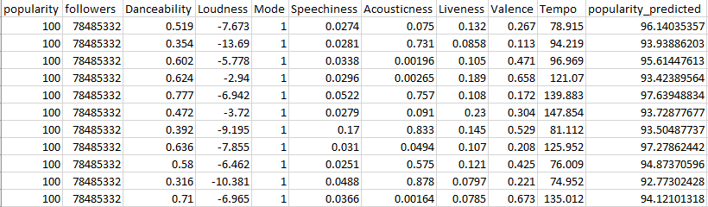
Introduction and Problem Statement
9 independent variables from Spotify, one response variable (popularity), plus predicted popularity.
Notes:
I want to remove this slide…and you talk to it with the next slide…

Slide 34
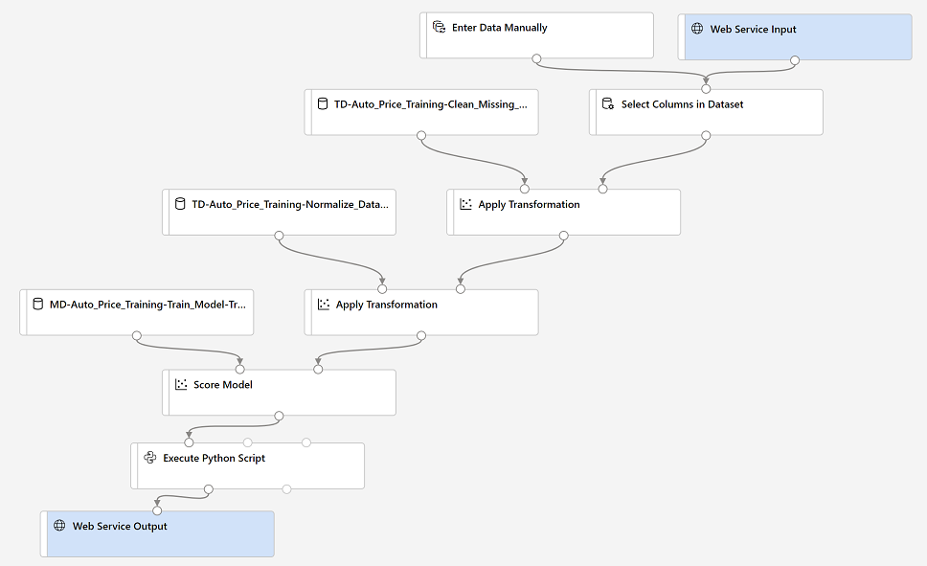
Phase 2: Enhancements
Notes:
I think a link and you do a quick walk through would be more of a benefit then this slide

Slide 35




Limitations
Yes! We can use ODBC Driver 17 for Sql Server.
Is there a different way to load your data to the database?
This Photo by Unknown Author is licensed under CC BY-SA

Slide 36
The End!

Slide 37
Links
Azure Rhythm Application | Landing Page
Rshiny App Break Down
Coursera Machine Learning

Slide 38
Contacts
Haitie Liu - haitiel@mail.smu.edu
Mai Dang - maid@mail.smu.edu
Lijo Jacob - lijoj@mail.smu.edu
Todd Garner - toddg@mail.smu.edu
Lani Lewis - lanil@mail.smu.edu

Slide 39
Thank You!

